Slide 1

LECTURE 3
I O N I C + A N G U L A R
DANIEL R YS JAN VÁCL AVÍK

Slide 2
O V E R V I E W
Project structure
Routing
Model
View
Controller

Slide 3
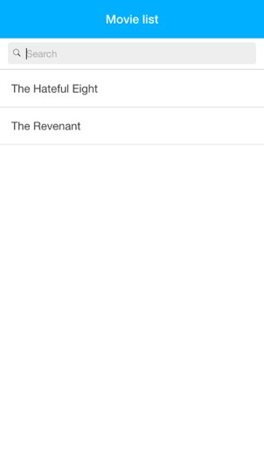
T O D AY ’ S G O A L

Slide 4
C R E AT E N E W P R O J E C T
$ ionic start movie-app blank
$ cd movie-app/
$ cordova platform add android
$ ionic serve

Slide 5
P R O J E C T S T R U C T U R E

Slide 6
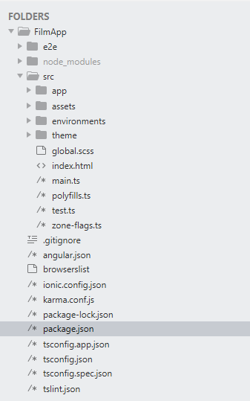

Slide 7
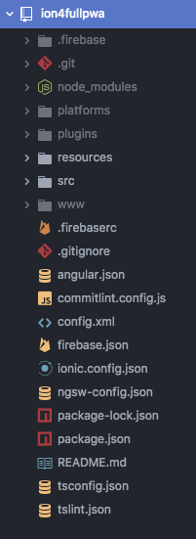
P R O J E C T S T R U C T U R E
With Cordova

Slide 8

The npm packages installed in the project with the npm install command.

Slide 9
when building the app for different platforms (like iOS or android), this folder will be automatically generated with all the files needed. (only for cordova project)

Slide 10
will be automatically generated with the required cordova plugins like keyboard or splashscreen. (only for cordova project)

Slide 11
when building the app for different platforms (like iOS or android), this folder will be automatically generated with the app resources like the logo and the splash screen image. You should put your own resources here.

Slide 12
the most important folder and where the majority of the app will be developed.

Slide 13
This folder is generated automatically and you shouldn't change anything from here. It's where all the compiled files will go.

Slide 14
package manager to handle all the third-party libraries and modules our app uses.

Slide 15
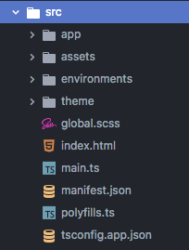
The npm packages installed in the project with the npm install command.

Slide 16
all the components, modules, pages, services and styles you will use to build your app.

Slide 17
sample images, sample-data json’s, and any other asset you may require in your app.

Slide 18
configuration files used by the Angular CLI to manage the different environment variables

Slide 19
all the theming, variables and sass mixins to be used in our ionic app.

Slide 20
This is the main entry point for the app

Slide 21
all the theming, variables and sass mixins to be used in our ionic app.

Slide 22
This file is the app manifest to be used for the progressive web app.

Slide 23
This file extends tsconfig.json main file and adds some specific configuration for the app.

Slide 24
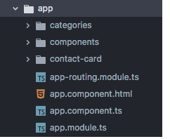
define the main routes. Child routes of other lazy modules are defined inside those modules.

Slide 25
Typically has a <ion-router-outlet> to render the routes and their content. It can also be wrapped with content that you want to be in every page

Slide 26
It’s the Angular component that provides functionality to the html file I just mentioned about.

Slide 27
This is the main module of the ionic project.

Slide 28
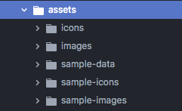
images, sample-data json’s, and any other asset you may require in your app

Slide 29
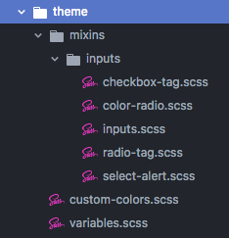
all the variables, mixins, shared styles, etc, that will make your app customizable and extendable.

Slide 30

W H AT I S A N G U L A R ?

Slide 31
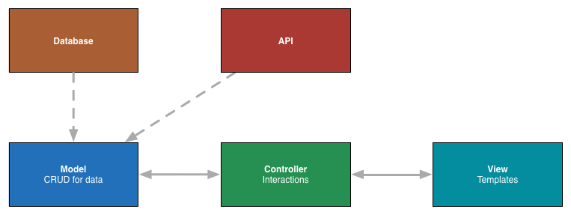
W H AT I S A N G U L A R ?
Front-end Javascript MVC framework

Slide 32
W H AT I S A N G U L A R ?
Framework for creating single page apps
Modular architecture
Two way data binding – automatic render changes

Slide 33

R O U T I N G

Slide 34
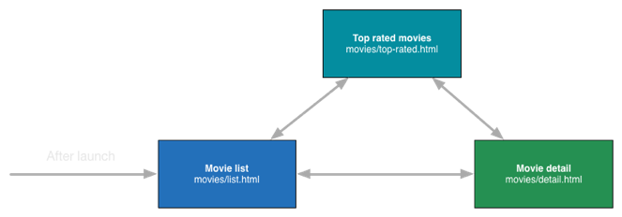
R O U T I N G
App is always in some application state
Every state has own URL, template, controller
“1 screen in the app = 1 route”
Example:

Slide 35


R O U T I N G
App is always in some application state
Every state has own URL, template, controller
“1 screen in the app = 1 route”
Application states
Example:

Slide 36
D E F I N I N G A P P S TAT E S
src/app/app-routing.ts
const routes: Routes = [
{path: 'home', loadChildren: './home/home.module#HomeModule' },
{path: ‘movies', loadChildren: './movies/movies.module#MovieListModule' },
{path: ‘movies/:id', loadChildren: './movie/movie.module#MovieDetailModule' }
]

Slide 37




D E F I N I N G A P P S TAT E S
State parameter
E. g. /movies/423
App state name
const routes: Routes = [
{
path: 'movies/:id',
loadChildren : './movie/movie.module#MovieDetailModule’
}
];
URL to template
Controller name

Slide 38
M O D E L

Slide 39
M O D E L
CRUD for data from API / DB / Local Storage
Create, Read, Update, Delete

Slide 40
D E F I N I N G D ATA I N M O D E L
src\app\home\home.page.ts
const data = [
{
"title": "The Hateful Eight",
"release_date": "2015-12-25",
"vote_average": "7.12",
"vote_count": "497"
},
{
"title": "The Revenant",
"release_date": "2015-12-25",
"vote_average": "7.2",
"vote_count": "507"
}
]

Slide 41

D E F I N I N G D ATA I N M O D E L
www/model/movies-service.js
1 app.factory('MoviesService', function () {
2
3
4
5
6
7
8
9
10
11
12
13
14
15
16
17
18
19
20
21 });
return new (function () { var service = this; service.data = {}; service.data.movies = [
{
"title": "The Hateful Eight", "release_date": "2015-12-25",
"vote_average": "7.12",
"vote_count": "497"
},
{
Why?
"title": "The Revenant", "release_date": "2015-12-25",
"vote_average": "7.2",
"vote_count": "507"
},
]
})();

Slide 42
C O N T R O L L E R

Slide 43
C O N T R O L L E R
Handling user interactions
E. g. button tap, gestures
Communicate with View and Model

Slide 44

C O N T R O L L E R
In file
src/app/home/home.page.ts
View
Style
@Component({
selector: 'app-home',
templateUrl: 'home.page.html',
styleUrls: ['home.page.scss'],
})
export class HomePage {
...
}

Slide 45
C O N T R O L L E R
export class HomePage {
private listFilms = null;
constructor() {
this.getFilmData();
}
getFilmData(){
//defind model
const data = [
.....
]
this.listFilms = data;
}
}
Model

Slide 46


M O D E L – V I E W R E L AT I O N
src/app/home/home.service.ts
getFilmData(){
return this.http.get(url_api);
}
Injecting MoviesService as dependency
src/app/home/home.page.ts
constructor(private filmService: HomeService){
this.filmService.getFilmData().subscrible( (res:any) => {
this.listFilms = JSON.parse(res);
})
}

Slide 47
V I E W

Slide 48
V I E W
Angular template
Can access anything in $scope variable

Slide 49
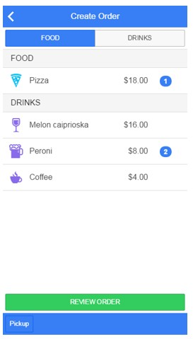
V I E W S T R U C T U R E
ion-view
<ion-view>
<ion-header-bar></ion-header-bar>
<ion-subheader-bar></ion-subheader-bar>
<ion-content></ion-content>
<ion-subfooter-bar></ion-subfooter-bar>
<ion-footer-bar></ion-footer-bar>
</ion-view>
ion-view, ion-content are mandatory

Slide 50

V I E W S T R U C T U R E
ion-view
<ion-view>
<ion-header-bar></ion-header-bar>
<ion-subheader-bar></ion-subheader-bar>
<ion-content></ion-content>
<ion-subfooter-bar></ion-subfooter-bar>
<ion-footer-bar></ion-footer-bar>
</ion-view>
ion-view, ion-content are mandatory

Slide 51

V I E W S T R U C T U R E
ion-view
<ion-view>
<ion-header-bar></ion-header-bar>
<ion-subheader-bar></ion-subheader-bar>
<ion-content></ion-content>
<ion-subfooter-bar></ion-subfooter-bar>
<ion-footer-bar></ion-footer-bar>
</ion-view>
ion-view, ion-content are mandatory

Slide 52
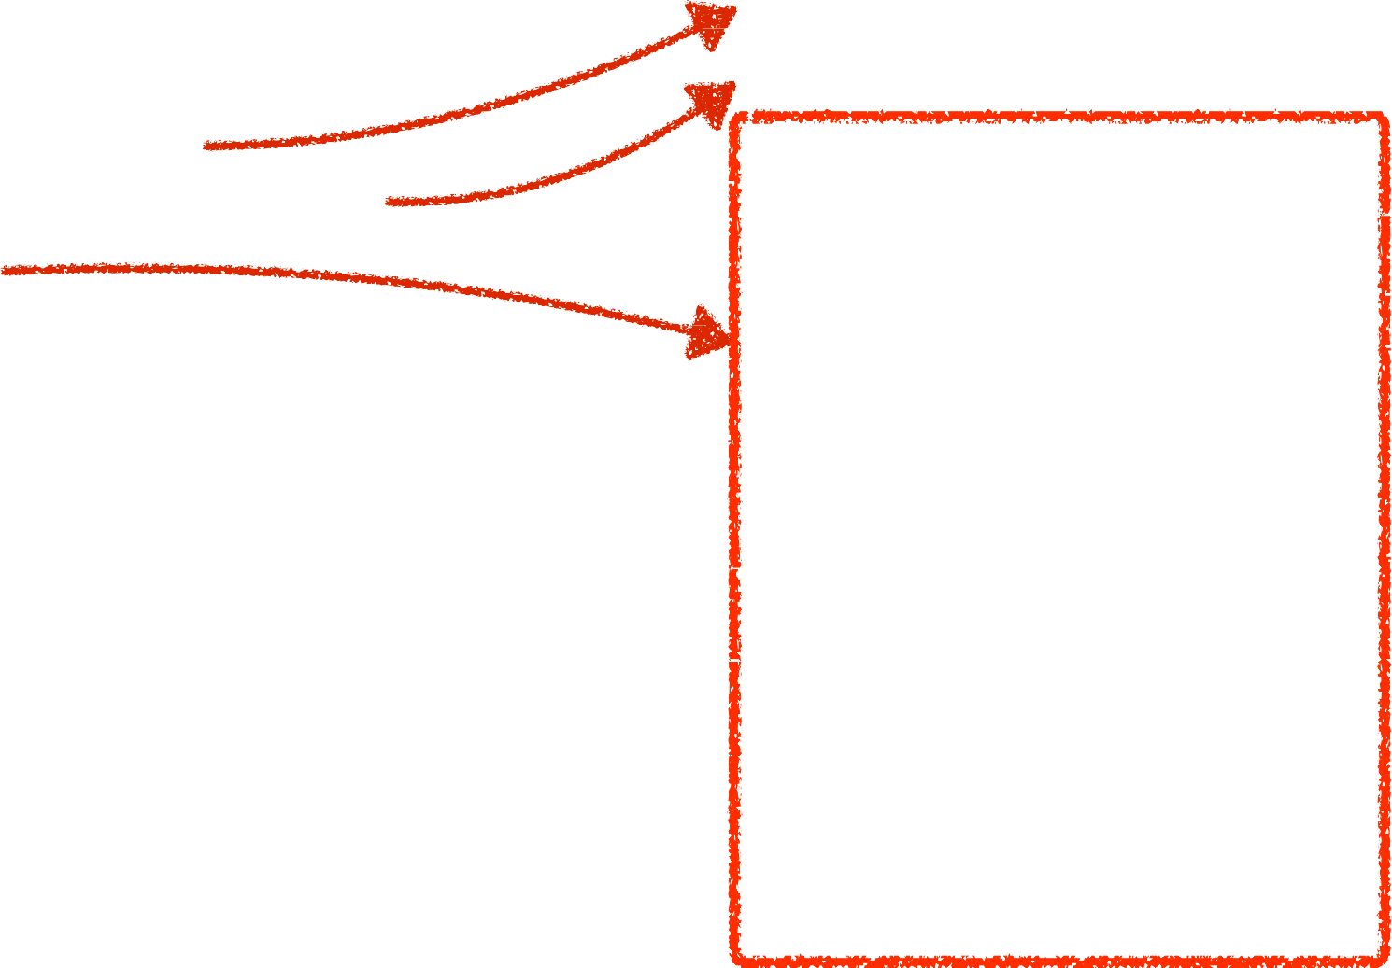
V I E W S T R U C T U R E
ion-view
<ion-view>
<ion-header-bar></ion-header-bar>
<ion-subheader-bar></ion-subheader-bar>
<ion-content></ion-content>
<ion-subfooter-bar></ion-subfooter-bar>
<ion-footer-bar></ion-footer-bar>
</ion-view>
ion-view, ion-content are mandatory

Slide 53

V I E W S T R U C T U R E
ion-view
<ion-view>
<ion-header-bar></ion-header-bar>
<ion-subheader-bar></ion-subheader-bar>
<ion-content></ion-content>
<ion-subfooter-bar></ion-subfooter-bar>
<ion-footer-bar></ion-footer-bar>
</ion-view>
ion-view, ion-content are mandatory

Slide 54

V I E W S T R U C T U R E
ion-view
<ion-view>
<ion-header-bar></ion-header-bar>
<ion-subheader-bar></ion-subheader-bar>
<ion-content></ion-content>
<ion-subfooter-bar></ion-subfooter-bar>
<ion-footer-bar></ion-footer-bar>
</ion-view>
ion-content are mandatory

Slide 55


V I E W
src/app/home/home.page.html
<ion-content>
<ion-list>
<ion-item *ngFor="let item of listFilms" (click)= "item_click(item.title)“ >
{{item.title}}
</ion-item>
</ion-list>
</ion-content>
For each in $scope.data.movies
Display movie title

Slide 56
D I R E C T I V E S

Slide 57
D I R E C T I V E S
“Component” with custom functionality
Can have own template and controller
Can be defined as element, attribute, class, comment
https://docs.angularjs.org/guide/directive

Slide 58
D I R E C T I V E S
<ion-item ng-repeat="movie in data.movies">
<strong>{{movie.title}}</strong>
</ion-item>

Slide 59

D I R E C T I V E S
ion-item is an element directive
<ion-item ng-repeat="movie in data.movies">
<strong>{{movie.title}}</strong>
</ion-item>

Slide 60

D I R E C T I V E S
ion-item is an element directive
<ion-item ng-repeat="movie in data.movies">
<strong>{{movie.title}}</strong>
</ion-item>
ng-repeat is an attribute directive

Slide 61
E X A M P L E S O F D I R E C T I V E S
ng-repeat (A)
Foreach in view
ion-list (E)
Render list with default style for mobile devices
ng-if (A)
Condition for rendering element

Slide 62
F I LT E R S

Slide 63
F I LT E R S
Helps with data filtering and formatting
Also for using in ng-repeat directive in views
You can specify own filters

Slide 64
B A S I C S E A R C H I N L I S T
1 <ion-view title="Movie list" id="view-movies-list">
2
3
4
5
6
<ion-content>
<div class="item-input-inset">
<label class="item-input-wrapper">
<i class="icon ion-ios-search"></i>
<input type="search" ng-model="searchString" placeholder="Search">
</label>
</div>
<ion-list>
<ion-item
ng-repeat="movie in data.movies | filter: searchString">
{{movie.title}}
</ion-item>
</ion-list>
7
8
9
10
11
12
13
</ion-content>
</ion-view>

Slide 65

B A S I C S E A R C H I N L I S T
Using filter called “filter” with argument “searchString”
1 <ion-view title="Movie list" id="view-movies-list">
2
3
4
5
6
<ion-content>
<div class="item-input-inset">
<label class="item-input-wrapper">
<i class="icon ion-ios-search"></i>
<input type="search" ng-model="searchString" placeholder="Search">
</label>
</div>
<ion-list>
<ion-item
ng-repeat="movie in data.movies | filter: searchString">
{{movie.title}}
</ion-item>
</ion-list>
7
8
9
10
11
12
13
</ion-content>
</ion-view>

Slide 66
D O N E !

Slide 67
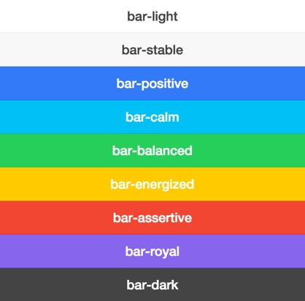
H E A D E R B A R C O L O R
<ion-nav-bar class="bar-positive">
<ion-nav-back-button>
</ion-nav-back-button>
</ion-nav-bar>
scss/partials/_variables.scss
$positive: #08b1ff !default;

Slide 68

H E A D E R B A R C O L O R
www/index.html
<ion-nav-bar class="bar-positive">
<ion-nav-back-button>
</ion-nav-back-button>
</ion-nav-bar>
scss/partials/_variables.scss
$positive: #08b1ff !default;

Slide 69
H O M E W O R K
Implement new features
http://goo.gl/GnEE8E
http://zdrojak.cz/clanky/vyvijime-hybridni-aplikace-v-ionicu

Slide 70
Q U E S T I O N S ?

Slide 71
JAN VÁCL AVÍK
@janvaclavik
DANIEL R YS
@danielrys
WW W.USER TECHNOLOGIES.COM

